Slide 1
Finding Cases of Non-Overdose, Not Drug Poisoning in Montana
Montana, opioids, and ESSENCE
Cody Custis, MS; Tory Troeger, MSPH; Montana Department of Public Health and Human Services

Slide 2
What is ESSENCE?
A tool hosted by CDC’s National Syndromic Surveillance Program (NSSP) BioSense Platform
Updates once a day
Captures chief complaints (freeform text), discharge diagnoses (computer coded; ICD-10-CM) from emergency department electronic medical records
50 hospitals around the state contribute data
Notes:
Gives us more up-to-date information than hospital discharge data, which may take up to a year to get to us. However, hospital discharge data has been verified, so what is recorded in ESSENCE may not actually be the final diagnosis.

Slide 3
What is ESSENCE?
Surveillance systems for opioids in Montana
Vital statistics death – Territorial days

Slide 4
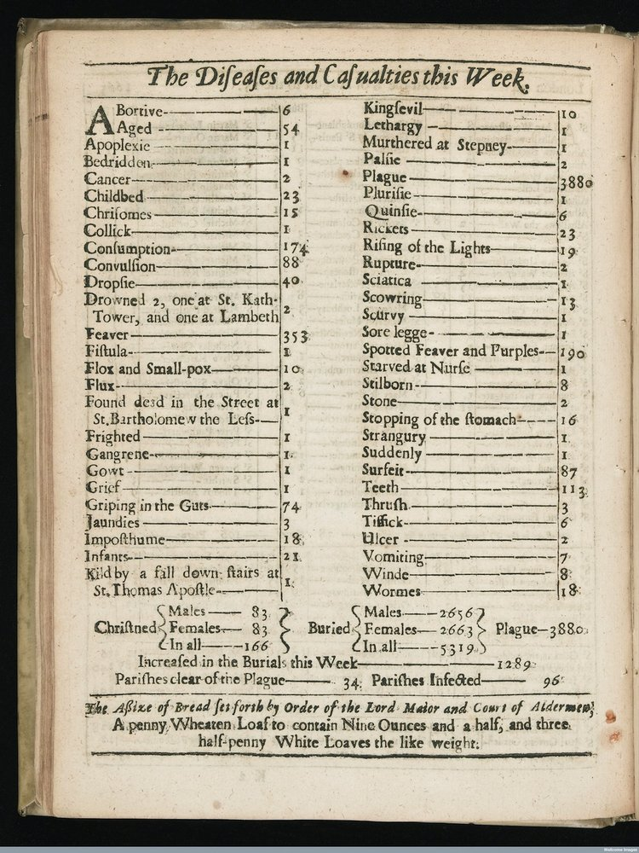
Notes:
Bill of Mortality from 1665 London

Slide 5
What is ESSENCE?
Surveillance systems for opioids in Montana
Vital statistics death – Territorial days
Hospital Discharge – Inpatient 2009 onward, Emergency Department 2013 onward

Slide 6
What is ESSENCE?
Inpatient, Emergency Department
ICD-10-CM:
T40.1X2A, Poisoning by heroin, accidental (unintentional), initial encounter

Slide 7
What is ESSENCE?
Selected surveillance systems for opioids in Montana
Vital statistics death – Territorial days
Hospital Discharge – Inpatient 2009 onward, Emergency Department 2013 onward
ESSENCE - 2017
Prescription Drug Monitoring Program – May 2018

Slide 8
Montana ESSENCE
Code developed by NSSP used to search for all opioid-related ER visits
Search Terms (with various spellings): Narcan, naloxone, poison, overdose, nodding, snort, ingest, intoxicated, unresponsive, loss of consciousness, overdose, syncope, shortness of breath, altered mental status, heroin, speedball, dope, opioid, opiate, methadone, suboxone, oxy, Percocet, Vicodin, fentanyl, hydrocodone, morphine, codeine, oxymor, dilaud, hydromor, tramad, suboxin, buprenorphine

Slide 9
Montana ESSENCE
Patient threatened to overdose on narcotic medication, but were taken to hospital before they ingested anything
Patient suffered an injury and were given pain medication prior to arrival at ED, and narcotics had nothing to do with initial injury
Medication refills
Patients who were given Narcan by EMS but their discharge/patient history had no mention of narcotic use, misuse, dependence, or overdose
Overdose of drug other than opioids

Slide 11
Montana ESSENCE
Challenges
Freeform text analysis (“not drug poisoning”); better algorithms to minimize manual review
Computer assigned ICD-10-CM codes; inpatient and emergency department assigned by trained medical coders
ESSENCE picks up acute trends; inpatient and emergency department better designed for comparison
Phrasing of chief complaint; differences from facility to facility and physician to physician
Notes:
“Pesticide exposure, not drug poisoning”
“Drug poisoning, not due to methamphetamines”
“code that I use excludes cases where a patient denies that there has been drugs in use or if they are coming in for detox or withdrawal symptoms, so that takes care of some false positives as well. “

Slide 12
Montana ESSENCE
Cody Custis, Montana Hospital Discharge Data System Epidemiologist, ccustis@.mt.gov
Tory Troeger, Opioid Epidemiologist, Victoria.Troeger@mt.gov
Opioids topics page: http://ibis.mt.gov/topic/healthoutcomes/Opioids.html

