Slide 1
GAISE-ing into Theory: Statistical Thinking in Mathematical Statistics
Jennifer L. Green
Department of Mathematical Sciences, MSU
Montana ActiveStatistics Conference
June 29, 2018

Slide 2
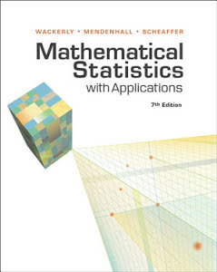
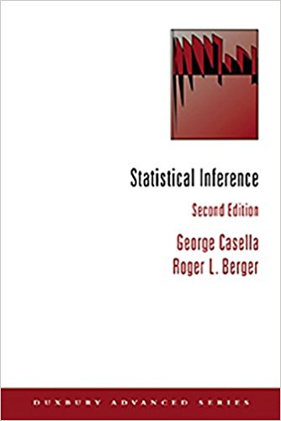
Course Description
Two semester probability/distribution theory and statistical inference sequence
Audience: Statistics, Mathematics, Actuarial Science, Allied Disciplines (e.g., Engineering, Economics)

Slide 3
Course Topics
Probability Theory (First Semester):
  Probability rules, Conditional probability, Distribution functions, Moments and Moment generating functions, Named distributions, Multiple random variables, Transformations, Sampling distributions
Mathematical Statistics (Second Semester):
  Order statistics, Point estimation, Evaluating estimators, Likelihood ratio tests, Interval estimation

Slide 4
Course Instruction
How do you think these topics are typically taught?
How do you think these topics should be taught? Why?

Slide 5

Mathematical Statistics
“moderate our romance with mathematics”
(Friedman, 2001, p. 9)
Mathematics
Empirical Validation

Slide 6
Undergraduate Statistics Programs
Students need opportunities to “develop flexible problem-solving skills;…[synthesize] theory, methods, computation, and applications;…work in teams;…[and] refine communication skills.”
-- American Statistical Association,
2014 Curriculum Guidelines for Undergraduate Programs in Statistical Science

Slide 7
GAISE Recommendations (2016)
Teach statistical thinking
Focus on conceptual understanding
Integrate real data with a context and purpose
Foster active learning
Use technology to explore concepts and analyze data
Use assessments to improve and evaluate student learning

Slide 8
Statistical Thinking: Real vs. Fake Coin Flips
Does this sequence of heads (“H”) and tails (“T”) represent 100 'real' or 100 'fake' flips? How could we decide?
H H T T H T H T H T
T T H H T T T H H H
T H T T T H H H T H
T H T H H H T T T T
H H H H T T T H T H
H H T T H H T T T T
H H H T H T H T T T
T H T H T T H H H H
T T H H H T T T H H
T H T H T H T T T H
-- Adapted from Gelman & Nolan (2002)

Slide 9
Statistical Thinking: Real vs. Fake Coin Flips

Slide 10
Statistical Thinking: Real vs. Fake Coin Flips

Slide 11
Statistical Thinking: Real vs. Fake Coin Flips

Slide 12
Statistical Thinking: Real vs. Fake Coin Flips
Introduction to R
Simulation
Statistical Investigative Process
  Using data to make decisions
  Problem solving

Slide 13
Conceptual Understanding: Sufficiency
Six scenarios for modeling the lifetime of a cell phone battery:

Slide 14
Real Data: Bootstrap Project
Identify a research question about a data set of interest
Devise two estimators to possibly answer the question and use bootstrap to compare their properties
Answer question using the “best” estimator

Slide 15
Real Data: Bootstrap Project
Connect theory with practice
Students explore varied contexts and questions of interest
  Does development in mountain Northwest occur more in areas with better access to outdoor recreation and amenities than in areas lacking these qualities?
  How many close friends and family do elderly report having?
  Are childcare providers in Montana paid below the poverty line?
  How do Rotten Tomato and Fandango movie ratings compare?

Slide 16
Active Learning
Using active learning methods in class allows students to discover, construct, and understand important statistical ideas as well as to engage in statistical thinking.
-- GAISE College Report 2016

Slide 17
Active Learning: Capture-Recapture
Students sample a small “pond” of cheddar goldfish crackers and use capture-recapture methods to estimate the total number of fish in their pond
Sampled cheddar fish are “marked” by replacing them in the pond with the same number of pretzel goldfish crackers; another sample is taken
Hypergeometric distribution used to motivate maximum likelihood estimation; resulting likelihood functions are graphed
-- Adapted from Scheaffer et al. (2004)

Slide 18
Active Learning: Capture-Recapture

Slide 19
Technology
Can promote student exploration and understanding of concepts (Buttrey et al., 2001; Green & Blankenship, 2015; Horton et al., 2004; Nolan & Temple Lang, 2003)
Offers flexibility and creativity
  Homework
  In-class problems, activities, and examples
  Projects
Extends across multiple probability theory and mathematical statistics topics (http://www.amstat.org/education/pdfs/GuidelineTopics.docx)

Slide 20
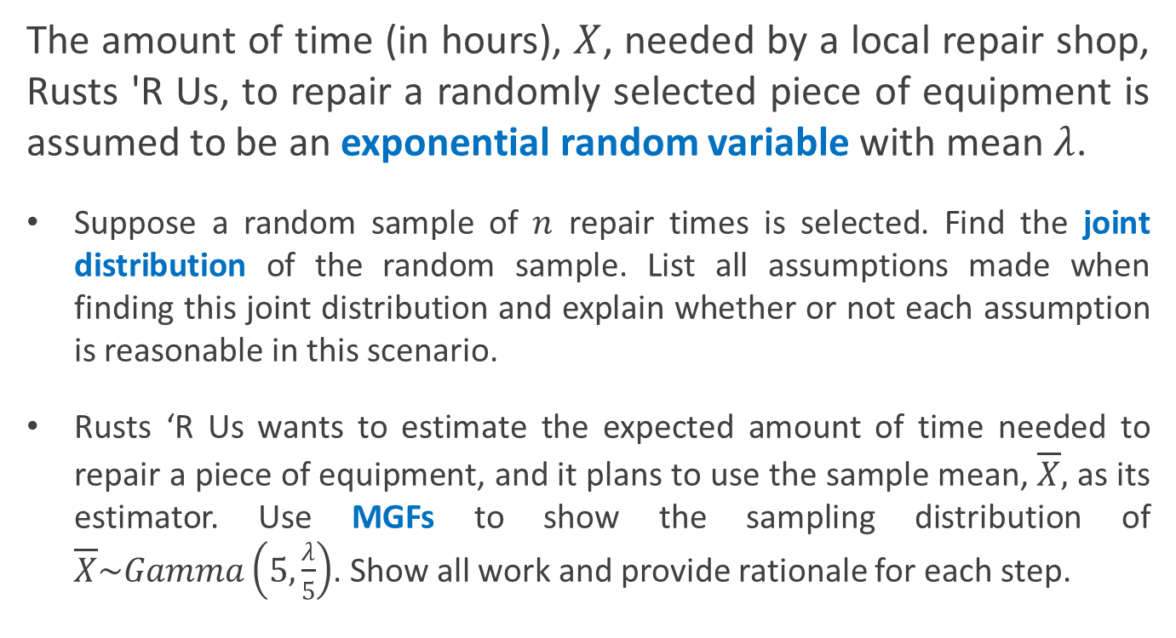
Technology: Sampling Distributions
The amount of time (in hours), $X$, needed by a local repair shop, Rusts 'R Us, to repair a randomly selected piece of equipment is assumed to be an exponential random variable with mean $λ$.
Suppose a random sample of $n$ repair times is selected. Find the joint distribution of the random sample. List all assumptions made when finding this joint distribution and explain whether or not each assumption is reasonable in this scenario.
Rusts ‘R Us wants to estimate the expected amount of time needed to repair a piece of equipment, and it plans to use the sample mean, $\overline{X},$ as its estimator. Use MGFs to show the sampling distribution of $\overline{X}\sim Gamma\left(5,\frac{λ}{5}\right)$. Show all work and provide rationale for each step.

Slide 21
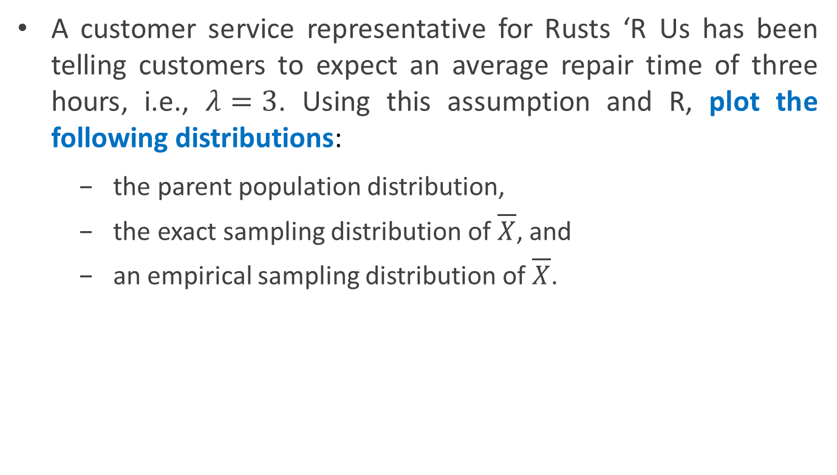
Technology: Sampling Distributions
A customer service representative for Rusts ‘R Us has been telling customers to expect an average repair time of three hours, i.e., $λ=3$. Using this assumption and R, plot the following distributions:
    the parent population distribution,
    the exact sampling distribution of $\overline{X}$, and
    an empirical sampling distribution of $\overline{X}$.

Slide 22
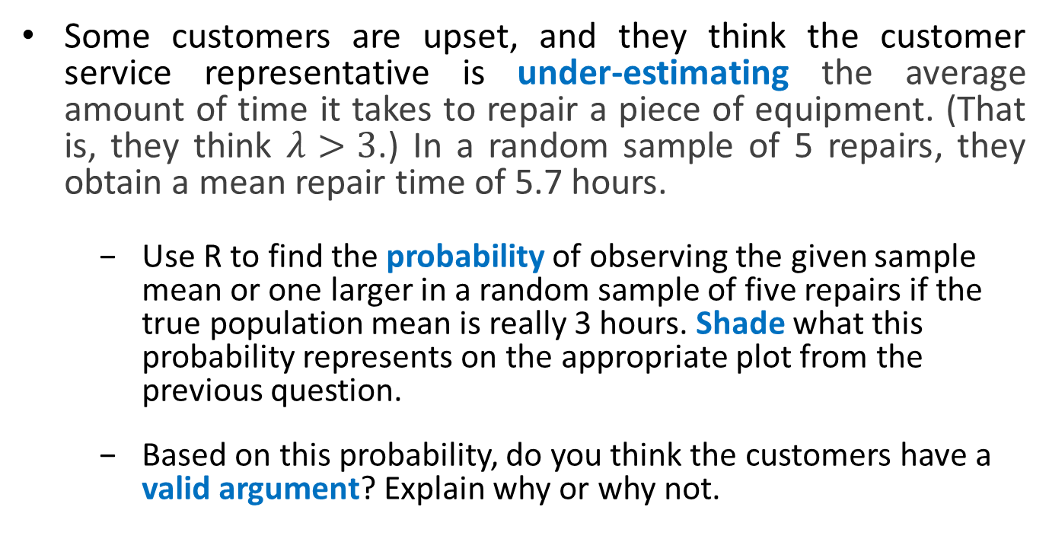
Technology: Sampling Distributions
Some customers are upset, and they think the customer service representative is under-estimating the average amount of time it takes to repair a piece of equipment. (That is, they think $λ>3$.) In a random sample of 5 repairs, they obtain a mean repair time of 5.7 hours.
    Use R to find the probability of observing the given sample mean or one larger in a random sample of five repairs if the true population mean is really 3 hours. Shade what this probability represents on the appropriate plot from the previous question.
    Based on this probability, do you think the customers have a valid argument? Explain why or why not.

Slide 23
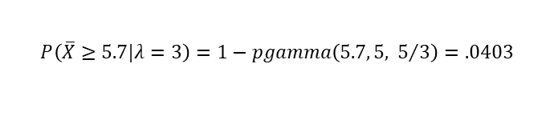
Technology: Sampling Distributions
$$P\left(\overline{X}≥5.7|λ=3\right)=1−pgamma\left(5.7, 5, { 5}/3\right)=.0403$$

Slide 24
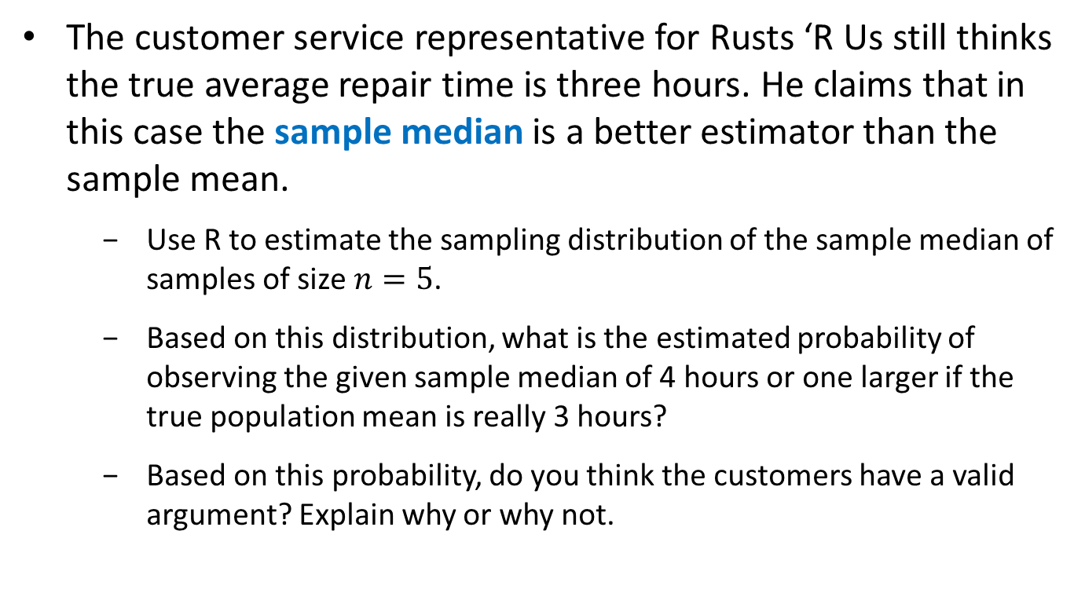
Technology: Sampling Distributions
The customer service representative for Rusts ‘R Us still thinks the true average repair time is three hours. He claims that in this case the sample median is a better estimator than the sample mean.
    Use R to estimate the sampling distribution of the sample median of samples of size $n=5$.
    Based on this distribution, what is the estimated probability of observing the given sample median of 4 hours or one larger if the true population mean is really 3 hours?
    Based on this probability, do you think the customers have a valid argument? Explain why or why not.

Slide 25
Technology: Sampling Distributions
$$\hat{P}\left(Median\left(X_{1},...,X_{5}\right)≥4|λ=3\right)=.135$$

Slide 26
Technology: Power Shiny App
Power Shiny App

Slide 27
Technology: Power Shiny App
Helps build intuition and conceptual understanding about power functions and
  Different statistics, hypotheses, etc.
  Relationships to sampling distributions
  Different population distributions (coming!)
Visualize concepts and ideas when derivations may be difficult and/or not intuitive

Slide 28
Assessments
Low-Stakes Writing Assignments (Writing to Learn)
  Significance articles focused on hypothesis testing and errors
    “For want of a nail: Why unnecessarily long tests may be impeding the progress of Western civilization” (Wainer & Feinberg, 2015)
    “Beyond reasonable doubt: catching the drug cheats at the London Olympics” (Erotokritou-Mulligan, Sonksen, & Holt, 2011)
    “Dare you buy a Henry Moore on eBay?” (Gastwirth, & Johnson, 2011)
High-Stakes Writing Assignments (Writing to Demonstrate Learning)
  Writing Distribution Questions Project (peer review)
  Meaningful Paragraph
  Rubric Construction
Exams

Slide 29
Assessments: Exam Question

Slide 30
Student Reflections
“[T]he format of the class allows for everyone to contribute to class discussions and emphasizes collaborative understanding, which I really like. So I feel that I was able to help my peers learn and vice versa through the discussion in the classroom.”
“The in class learning activities…were fun and I thought they were more productive than just lecturing would have been.”
“I really liked the applet. It was easy to visualize the relationship between power and sampling distributions.”

Slide 31
Student Reflections
“…we learned a lot of definitions and formulas but I thought the main idea of the class [was] how to manipulate and use these concepts on problems that were not simply ‘find the answer’ type of questions.”
“Seeing how all the ideas tied together and related to one another also was really fascinating and beneficial because [it] put the entire course sequence into perspective.”

Slide 32
Instructor Reflections
Moves beyond “canned formulas” to encourage real statistical thinking and understanding
Allows students to demonstrate deeper understanding
Little to no change to course content is required
Start small and adapt existing materials
  Communicate purpose, goals of changes with students – opportunities for problem solving, creativity, exploration, connections, etc.
Can easily adapt approaches and assessments for other courses

Slide 33


Contact Information and Collaborators
Jennifer L. Green, jgreen@montana.edu
Associate Professor of Statistics, Montana State University
Erin E. Blankenship, erin.Blankenship@unl.edu
Professor of Statistics, University of Nebraska-Lincoln
Christian A. Stratton
Ph.D. Student, Montana State University

Slide 34
References
ASA (2014). 2014 Curriculum Guidelines for Undergraduate Programs in Statistical Science. Alexandria, VA: American Statistical Association. http://www.amstat.org/education/curriculumguidelines.cfm.
Buttrey, S. E., Nolan, D., & Temple Lang, D. (2001). Computing in the mathematical statistics course. In Proceedings of the 2001 Joint Statistics Meetings, Alexandria, VA. American Statistical Association. Available at http://www.amstat.org/sections/srms/proceedings/y2001/proceed/00113.pdf.
Erotokritou-Mulligan, I., Sonksen, P., & Holt, R. (2011). Beyond reasonable doubt: catching the drug cheats at the London Olympics. Significance, 8(1), p. 5-9.
Friedman, J. H. (2001). The role of statistics in the data revolution? International Statistical Review, 69(1), 5–10.
GAISE College Report ASA Revision Committee. (2016). Guidelines for Assessment and Instruction in Statistics Education College Report 2016. http://www.amstat.org/education/gaise
Gastwirth, J., & Johnson, W. (2011). Dare you buy a Henry Moore on eBay? Significance, 8(1), p. 10-14.
Gelman, A., & Nolan, D. (2002). Teaching statistics: A bag of tricks. New York: Oxford University Press.
Green, J. L., & Blankenship, E. E. (2015). Fostering conceptual understanding in mathematical Statistics. The American Statistician, 69(4), 315–325.

Slide 35
References
Green, J. L., & Broatch, J. Making changes with technology in mathematical statistics. Poster at the Electronic Conference on Teaching Statistics, May, 2016. https://www.causeweb.org/cause/ecots/ecots16/posters/c/5
Horton, N. J., Brown, E. R., & Qian, L. (2004). Use of R as a toolbox for mathematical statistics exploration. The American Statistician, 58(4), 343-357.
Nolan, D., & Temple Lang, D. (2003). Case studies and computing: Broadening the scope of statistical education. In Proceedings of the 2003 International Statistical Institute Meeting. International Statistical Institute. Available at http://iase-web.org/documents/papers/isi54/3735.pdf.
Scheaffer, R. L., Watkins, A., Witmer, J., & Gnanadesikan, M. (2004). Activity-based statistics (2nd ed.). T. Erickson (Ed.). Emeryville, CA: Key College Publishing.
Stratton, C. A., & Green, J. L. The power of technology: A Shiny applet assisted approach to teaching statistical power. Poster at the Electronic Conference on Teaching Statistics, May, 2018. https://www.causeweb.org/cause/ecots/ecots18/posters/2-08
Wainer, H. and Feinberg, R. (2015). For want of a nail: Why unnecessarily long tests may be impeding the progress of Western civilisation. Significance, 12(1), p. 16-21.

