Slide 1
Six Ways to Integrate GAISE into Your Introductory Statistics Course
Stacey Hancock
Department of Mathematical Sciences, MSU
Montana ActiveStatistics Conference, Carroll College
June 28, 2018

Slide 2
Outline
What are the Guidelines for Assessment and Instruction in Statistics Education (GAISE)?
New emphases introduced in 2016
Three ways to integrate GAISE in what we teach
Three ways to integrate GAISE in how we teach
Where does data science fit in?

Slide 3
GAISE College Report
Guidelines for Assessment and Instruction in Statistics Education (GAISE) College Report endorsed by the ASA in 2005
Primarily focused on the introductory statistics course at two- and four-year institutions
First three focus on what to teach in introductory courses
Second three focus on how to teach introductory courses
Revised report with new emphases added in 2016.

Slide 4
GAISE College Report
Teach statistical thinking.
Teach statistics as an investigative process of problem-solving and decision-making.
Give students experience with multivariable thinking.
Focus on conceptual understanding.
Integrate real data with a context and purpose.
Foster active learning.
Use technology to explore concepts and analyze data.
Use assessments to improve and evaluate student learning.

Slide 5
Statistical Literacy, Reasoning, and Thinking
Ben-Zvi and Garfield (2004):
Statistical literacy includes basic and important skills that may be used in understanding statistical information or research results.
Statistical reasoning may be defined as the way people reason with statistical ideas and make sense of statistical information.
Statistical thinking involves an understanding of why and how statistical investigations are conducted and the “big ideas” that underlie statistical investigations.
Notes:
“Big ideas” =
omnipresent nature of variation
when and how to use appropriate methods of data analysis
understanding of the nature of sampling, how we make inferences from samples to populations
why designed experiments are needed to establish causation
how models are used to simulate random phenomena
how data are produced to estimate probabilities
how, when, and why existing inferential tools can be used to aid an investigative process
utilize the context of a problem in forming investigations and drawing conclusions
recognizing the entire process
critique and evaluate results of a problem solved or a statistical study

Slide 6
Nov 8, 2017
A Montana legislator in a guest column writes:
“A scatter-plot graph of tuition versus graduation rates in the 50 states reveals a strong correlation–low tuition is associated with low graduation rates, high with high.”

Slide 7
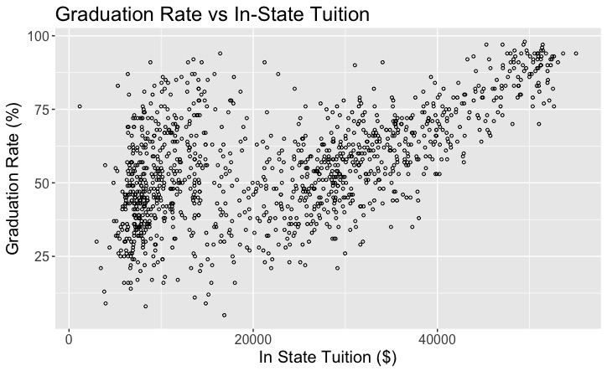
Data source:
U.S. Department of Education National Center for Education Statistics
https://nces.ed.gov
Notes:
Years 2016-2017

Slide 8
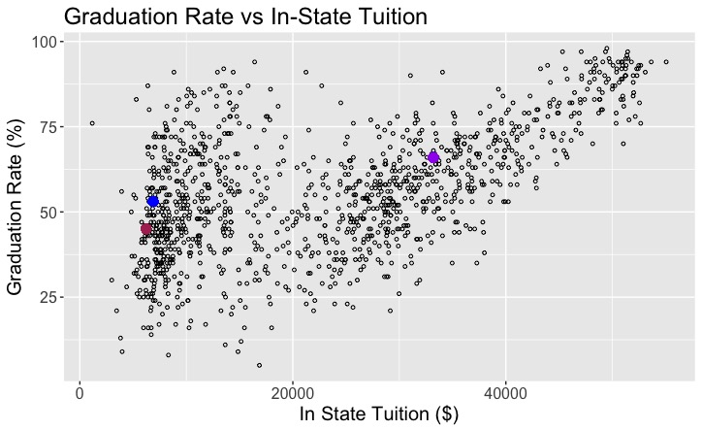
MSU
Carroll
U of M
Notes:
Years 2016-2017

Slide 9
MSU
Carroll
U of M
Notes:
Years 2016-2017

Slide 10
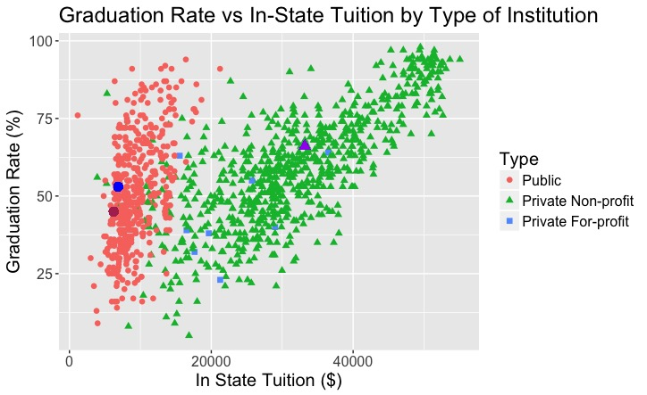

Slide 11
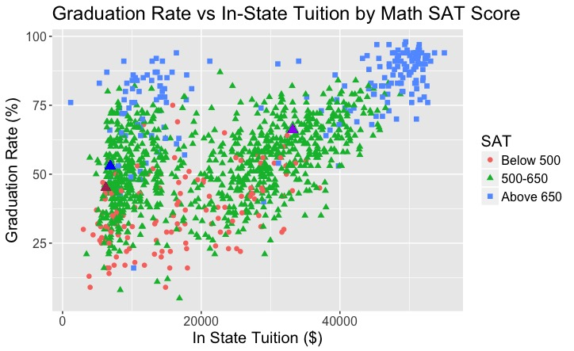
Notes:
MSU Math SAT = 630

Slide 12
Nov 8, 2017
“The clear expectation is that taxpayers should fork over escalating amounts to keep tuition low… [but] low tuition spurs a high dropout rate.” (emphasis added)

Slide 13
1. Data visualization
Exploratory data analysis with multiple variables can be introduced in the first week of the intro course
Tableau is a data visualization software that
is powerful and authentic,
is free for academic use,
provides a platform for sharing work,
has a drag-and-drop interface that facilitates data exploration,
produces quality graphics without requiring programming skills
requires minimal training in how to use the software.

Slide 14
Example: Roller Coaster Data
Sample of 157 roller coasters in the US that opened between 1915 and 2016
15 Variables: Coaster, Park, City, State, Type, Design, Year Opened, Top Speed, Max Height, Drop, Length, Duration, Inversions?, # of Inversions, Age Group
Data from Roller Coaster DataBase (https://rcdb.com/) and https://www.UltimateRollerCoaster.com/
Activity questions from ESTEEM: Enhancing Statistics Teacher Education with E-Modules (http://hirise.fi.ncsu.edu/project/esteem/)
Activity worksheet posted at: http://www.math.montana.edu/courses/s216/TableauActivityS18.pdf
Notes:
Mix of categorical and quantitative variables

Slide 15
Example: Roller Coaster Data
How fast is the fastest roller coaster? What is the name of this roller coaster?
Do newer roller coasters seem to have higher top speed than older ones? Create a data visualization that answers this question.
Are newer roller coasters more likely to be made of steel than older ones? What about roller coasters with a high top speed?
Is there a relationship between top speed and maximum height? Describe this relationship.
Investigate some other factors that you think might have a relationship with top speed. Create a Dashboard comprised of data visualizations which you think summarize the relationship between top speed and at least two other variables that seem to be related to top speed. Add text to the Dashboard and write a few sentences describing what you find.

Slide 16
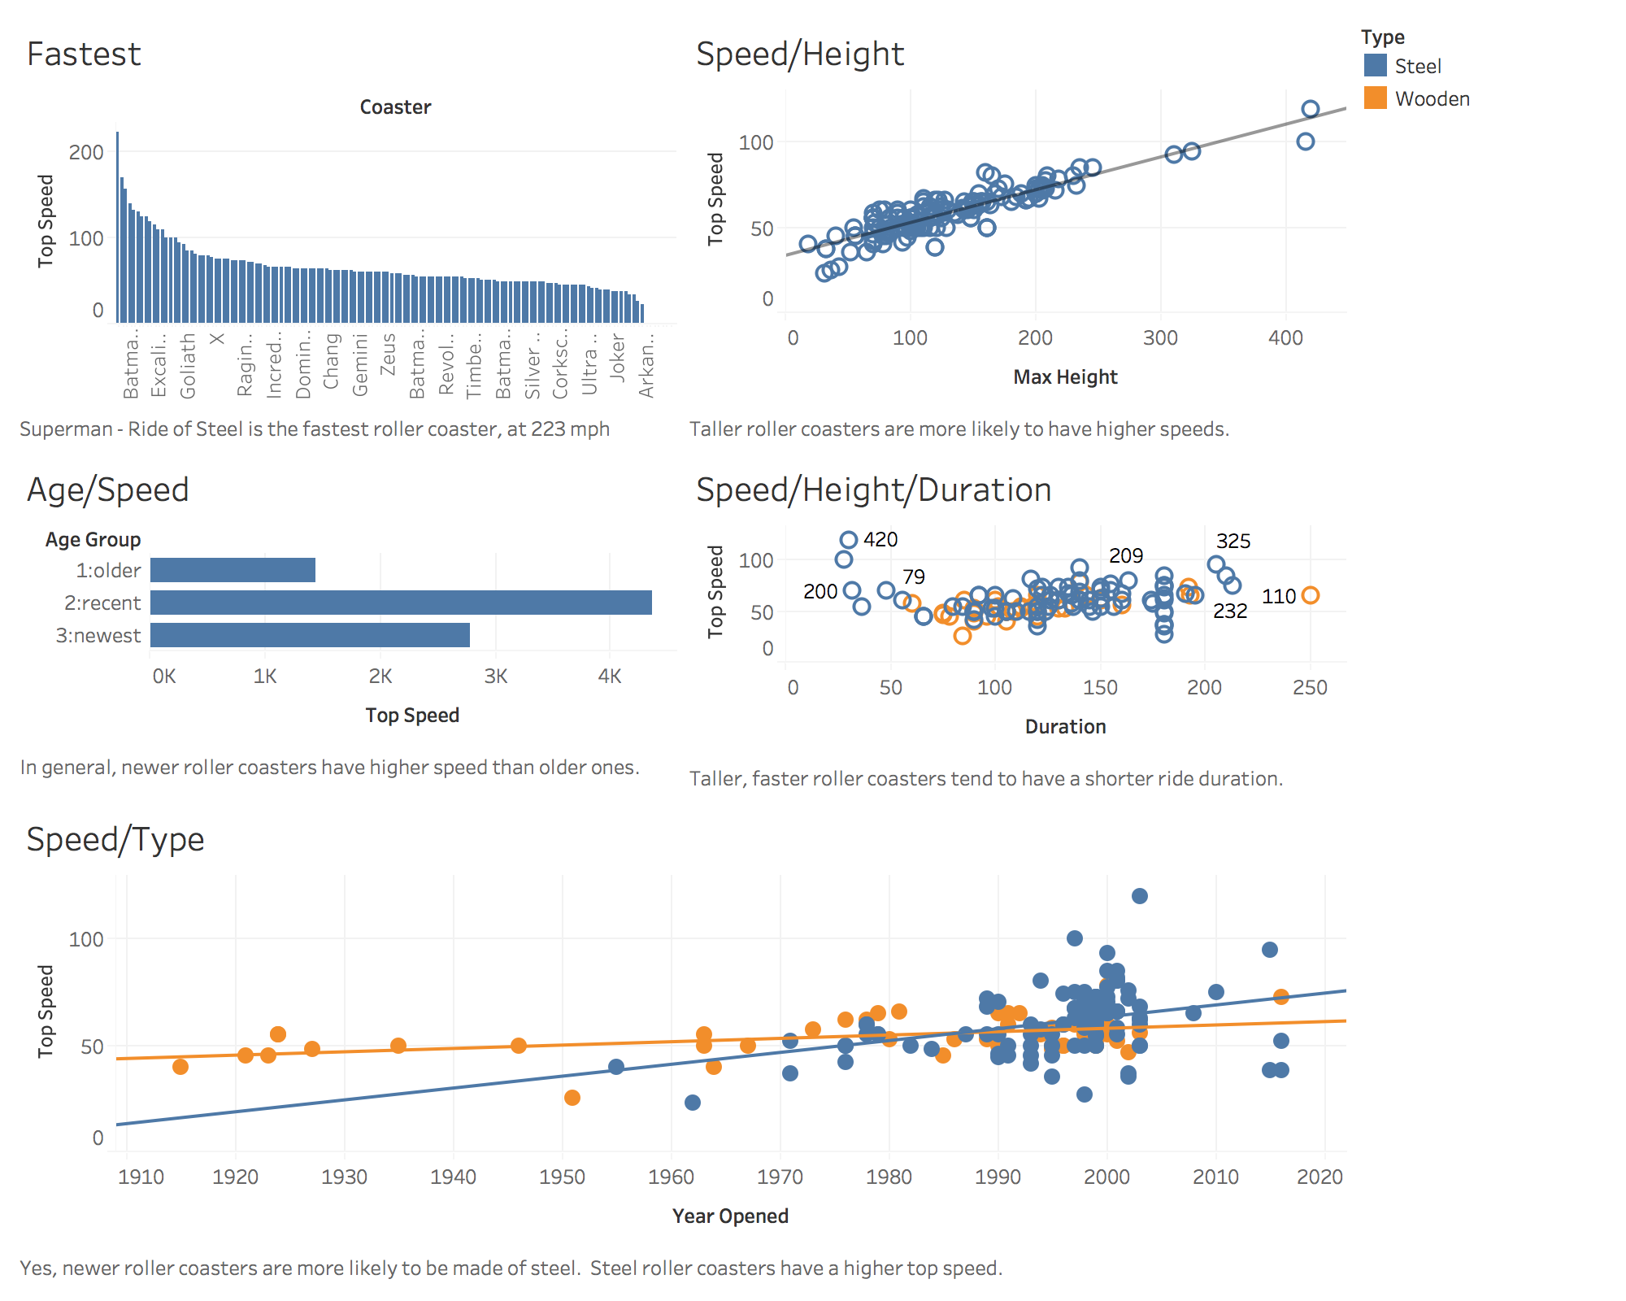
Notes:
Rollercoaster data from Roller Coaster DataBase and UltimateRollerCoaster.com.
Variables: Coaster, Park, City, State, Type, Design, Design Type, Opened, Top Speed, Max Height, Drop, Length, Duration, Inversions?, # of Inversions, Age Group.
Variable
Description
Coaster
Name of the roller coaster
Park
Name of the park where the roller coaster is located
City
City where the roller coaster is located
State
State where the roller coaster is located
Type
Material of track (Steel or Wooden)
Design
How a passenger is positioned in the roller coaster
Design Types:
Bobsled - designed like a bobsled run -- without a fixed track. The train travels freely through a trough.
Flying - a roller coaster ridden while parallel with the track.
Inverted - a roller coaster which uses trains traveling beneath, rather than on top of, the track. Unlike a suspended roller coaster, an inverted roller coaster's trains are rigidly attached to the track.
Pipeline - a coaster where riders are positioned between the rails instead of above or below.
Sit Down - a traditional roller coaster ridden while sitting down.
Stand Up - a coaster ridden while standing up instead of sitting down.
Suspended - a roller coaster using trains which travel beneath the track and pivot on a swinging arm from side to side, exaggerating the track's banks and turns.
Wing - a coaster where pairs of riders sit on either side of a roller coaster track in which nothing is above or below the riders.
Opened
Year when roller coaster opened
Top Speed
Maximum speed of roller coaster (mph)
Max Height
Highest point of roller coaster (ft)
Drop
Length of largest gap between high and low points of roller coaster (ft)
Length
Length of roller coaster track (ft)
Duration
Time length of roller coaster ride (sec)
Inversions?
Whether or not roller coaster flips passengers at any point (Yes or No)
# of Inversions
Number of times roller coaster flips passengers
Age Group:
1:Older (Built between 1900-1979)
2:Recent (1980-1999)
3:Newest (2000-current)

Slide 17
2. Simulation-based tests
Tintle et al. (2014) large scale empirical study on the use of randomization based methods in the intro course.
Overall, improvement on CAOS test was 11.6% for randomization curricula, and 5.6% for traditional (p-value < 0.001).
Randomization curricula showed significantly higher performance in: data collection and design, graphical representations, probability, confidence intervals, and tests of significance. (Randomization curricula significantly lower in descriptive statistics.)
Hildreth et al. (2018) found simulation-based curricula helped increase student understanding in several key concepts.

Slide 18
Example: Swimming with Dolphins
Is swimming with dolphins therapeutic for patients suffering from clinical depression?
 | Animal care program (dolphin therapy) | Outdoor nature program (control group) | Total
Showed substantial improvement | 10 | 3 | 13
Did not show substantial improvement | 5 | 12 | 17
Total | 15 | 15 | 30

Slide 19
www.rossmanchance.com/applets
10,000 shuffles (re-randomizations) of cards into 15 dolphin and 15 control
Blue cards = 13 “improvers”
Green cards = 17 “non-improvers”
p-value: 127 of the 10,000 re-randomizations resulted in a difference in proportions of 0.467 (observed) or higher

Slide 20
3. Bootstrapping confidence intervals
Idea behind sampling distributions:
Draw samples from the population, and
Compute the statistic of interest (mean, median, etc.) for each sample.
Idea behind bootstrapping:
Draw samples from an estimate of the population, and
Compute the statistic of interest for each sample.

Slide 21
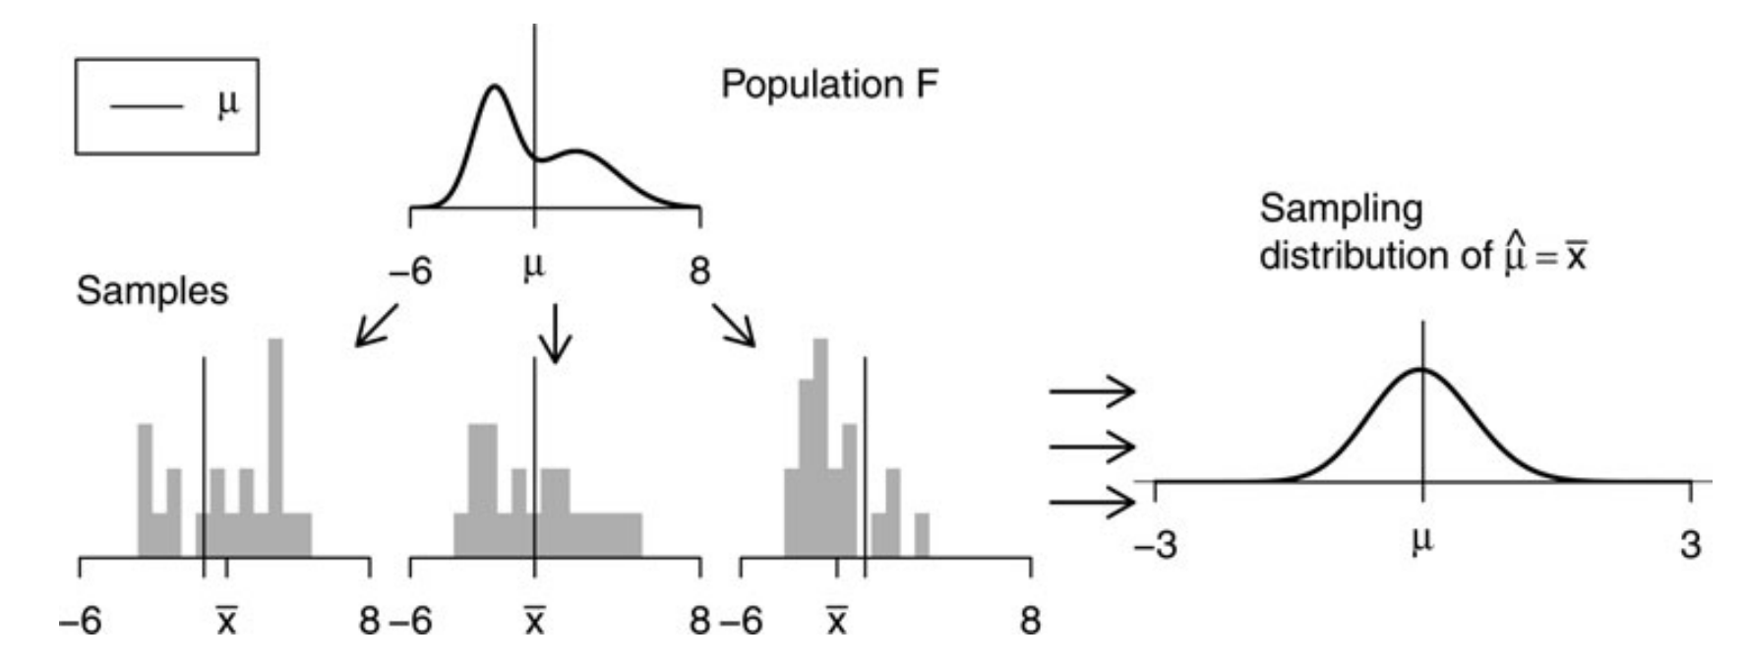
Sampling Distribution (Hesterberg, 2015)

Slide 22
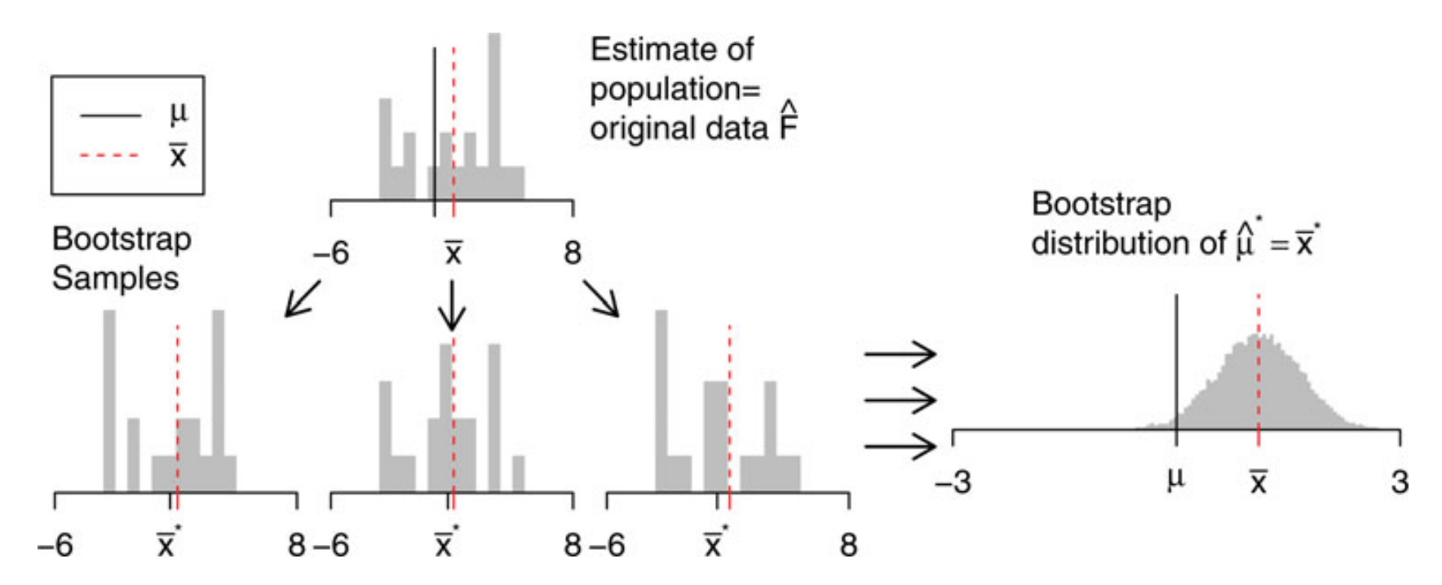
Bootstrap Distribution (Hesterberg, 2015)
Notes:
Substitute the empirical distribution for the population.
Now centered at sample estimate.

Slide 23
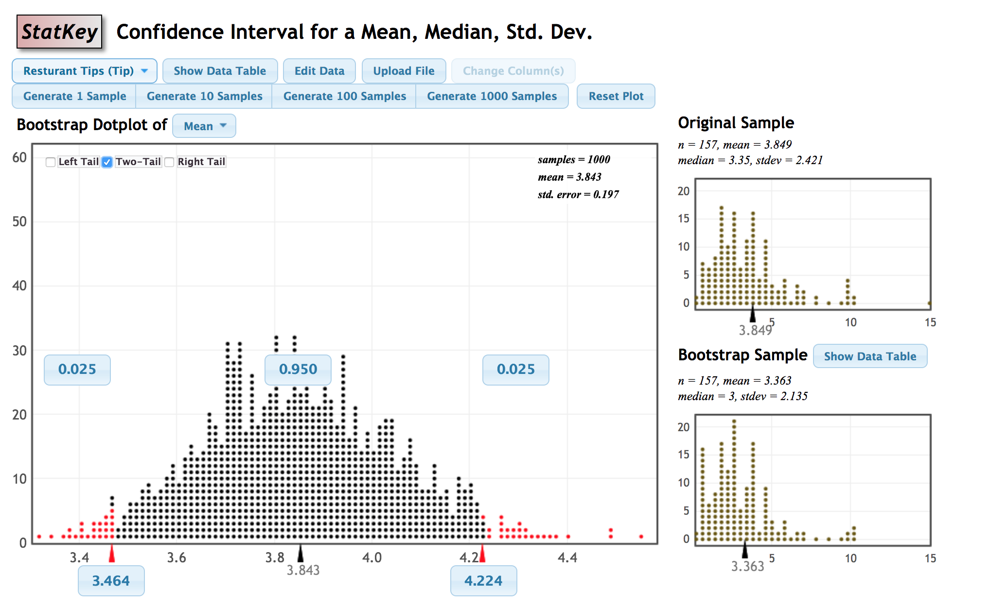
www.lock5stat.com/StatKey

Slide 24
Sampling variability is the core of statistical inference.
Pedagogical value of bootstrapping and simulation-based tests (Hesterberg, 2015):
Reinforces central role that sampling from a population plays in statistics
Sampling variability is visible
Measure variability of a sampling distribution using already familiar methods (sample standard deviation)
Reinforces the Central Limit Theorem
Makes the abstract concrete
Works with a wide variety of statistics
Focus on ideas rather than formulas
Notes:
- We sample from the data the same way we would sample from the population… could bootstrap with and without stratification to explore benefits of stratified sampling; can play with sample size
Possible misconceptions?
Bootstrap distn centered around sample estimate, not parameter – use to tell how accurate original estimate is. Use the data twice – once to compute an estimate, and again to compute a standard error for the estimate.

Slide 25
4. Exam reflections
Use the class day after an exam for a group activity where students work through a selection of exam problems.
Include metacognitive questions such as “what exam study strategies seemed to work well?”
Another option: two-stage collaborative exams

Slide 26
5. Student-led projects
Semester-long projects where students develop a research question, collect data, analyze data, and communicate both with a presentation and written report.
Benefits:
Students work through the entire statistical investigation process
Help students develop soft skills – working in a team, communication, project organization
Increase student motivation since topic is generated from the student rather than from the instructor

Slide 27
Tips for Student Group Projects
Build in group evaluation into the project grade
Spread out multiple due dates throughout the semester
Teach students how to work in groups
Use collaborative project tools (e.g., Google Docs, Slides, Sheets)
Have students turn in draft of report in pieces

Slide 28
6. Flipped classroom
in class
Students introduced to content
Practice working through problems
at home
http://www.montana.edu/
pdc/projects/2013/teal.htm
Notes:
2013 started moving to simulation-based curriculum and flipped format

Slide 29
What does the research say?
Consistent with cognitive psychology research – generation effect, testing effect (Winquist & Carlson, 2014)
Student perceptions mixed, but generally positive; tend to prefer in-person lectures to video lectures, but prefer interactive classroom activities over lectures (Bishop & Verleger, 2013)
Many single-classroom studies, but lacking large empirical studies using objective learning outcomes in controlled experiment/quasi-experiment (Bishop & Verleger, 2013)
Might improve student motivation and help manage cognitive load (Abeysekera & Dawson, 2015)
Notes:
Generation effect = we learn better when we generate something than when we read something
Testing effect = if we test ourselves before we learn, we’ll remember it better.
Activities need to be carefully designed and well-structured
There will invariably be a few students who strongly oppose the structure

Slide 30
 | GAISE Guideline
Activity | 1 | a | b | 2 | 3 | 4 | 5 | 6
What
1. Data visualization | ✅ |  | ✅ | ✅ | ✅ | ✅ | ✅
2. Simulation-based tests | ✅ |  |  | ✅ | ✅ | ✅ | ✅
3. Bootstrapping intervals | ✅ |  |  | ✅ | ✅ | ✅ | ✅
How
4. Exam reflections | ✅ |  |  |  |  | ✅ |  | ✅
5. Student-led projects | ✅ | ✅ | ✅ |  | ✅ | ✅ | ✅ | ✅
6. Flipped classroom | ✅ |  |  |  |  | ✅ | ✅ | ✅
Notes:
Teach statistical thinking.
Teach statistics as an investigative process of problem-solving and decision-making.
Give students experience with multivariable thinking.
Focus on conceptual understanding.
Integrate real data with a context and purpose.
Foster active learning.
Use technology to explore concepts and analyze data.
Use assessments to improve and evaluate student learning.

Slide 31
“Big Data” and Data Science
https://marketoonist.com/2017/03/bigdata.html

Slide 32
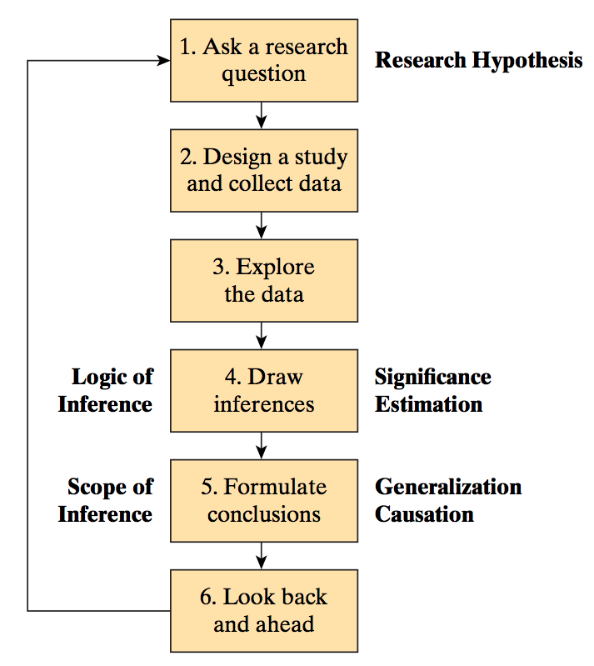
Teaching Data Literacy in the World of Big Data
“Found data” – How were these data generated? For what purpose? What sources of bias are present? What research questions could we investigate?
Data visualization and multivariable thinking
To which larger group (if any) do these results apply? Coincidence, correlation, or causation?
Is the analysis transparent? How large could it scale? Could this model be used to damage or destroy lives?
Tintle et al., 2016

Slide 33
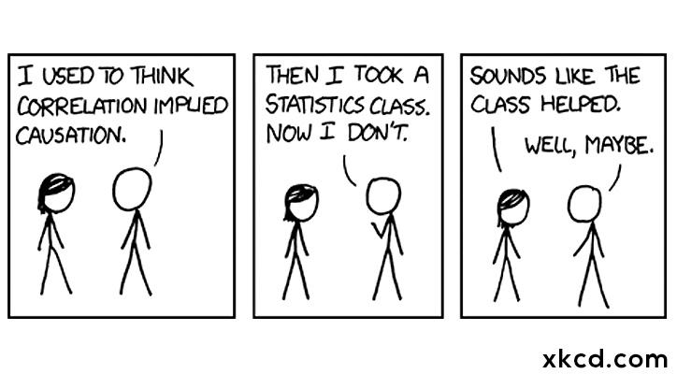
Thank you!
https://xkcd.com/552/

Slide 34
Other Guidelines and References
ASA Curriculum Guidelines for Undergraduate Programs in Statistical Science
ASA’s Statement on p-Values
Curriculum Guidelines for Undergraduate Programs in Data Science, Annual Review of Statistics and Its Application, Vol. 4:15-30, 2016
The American Statistician special issue on statistics and the undergraduate curriculum, Vol. 69, No. 4, 2015
Notes:
http://www.amstat.org/education/pdfs/guidelines2014-11-15.pdf
Wasserstein, R. L., and Lazar, N. A. (2016), “The ASA’s Statement on p-Values: Context, Process, and Purpose,” The American Statistician, 70. http://dx.doi.org/10.1080/00031305.2016.1154108.

Slide 35
References
Abeysekera & Dawson (2015). Motivation and cognitive load in the flipped classroom: definition, rationale and a call for research, Higher Education Research & Development, Vol 34, Issue 1, pp. 1-14.
Ben-Zvi, D. and Garfield, J. (2004). Statistical literacy, reasoning, and thinking: Goals, definitions, and challenges. In J. Ben-Zvi and Garfield, D. (Ed.), The challenge of developing statistical literacy, reasoning and thinking (pp. 3-15). Dordrecht, The Netherlands: Kluwer.
Bishop, J. L., Verleger, M. A. (2013). The flipped classroom: A survey of the research, 120th ASEE Annual Conference & Exposition Proceedings, Paper ID #6219.
GAISE College Report ASA Revision Committee, “Guidelines for Assessment and Instruction in Statistics Education College Report 2016,” http://www.amstat.org/education/gaise.
Hesterberg, T. (2015). What teachers should know about the bootstrap: Resampling in the undergraduate statistics curriculum, The American Statistician, Vol 69, Issue 4, pp. 371-386. DOI: 10.1080/00031305.2015.1089789.
Hildreth, L. A., Robison-Cox, J., Schmidt, J. (2018). Comparing student success and understanding in introductory statistics uncer consensus and simulation-based curricula, Statistics Education Research Journal, Vol 17, No 1, pp. 103-120.
Tintle, N. L., Rogers, A., Chance, B., Cobb, G., Rossman, A., Roy, S., Swanson, T., and VanderStoep, J. (2014b). Quantitative evidence for the use simulation and randomization in the introductory statistics course, in Proceedings of the Ninth International Conference on Teaching Statistics, Vol ICOTS-9. Available at http://iase-web.org/icots/9/proceedings/pdfs/ICOTS9_8A3_TINTLE.pdf.
Winquist, J. R., Carlson, K. A. (2014). Flipped statistics class results: Better performance than lecture over one year later, Journal of Statistics Education, Vol 22, No 3. http://ww2.amstat.org/publications/jse/v22n3/winquist.pdf

